Slide 1

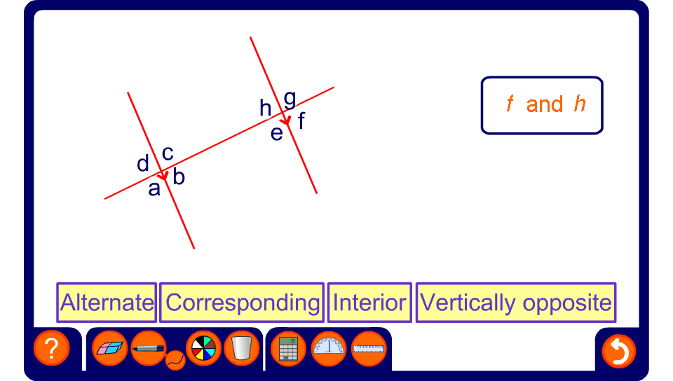


Angles and parallel lines

